Slide 1
No Conflict of Interest to declare

Slide 2

Considerations for differentiated service delivery for HIV prevention in the Fast Track Era
Wanjiru Mukoma, PhD
wanjiru.mukoma@lvcthealth.org
www.lvcthealth.org
LVCT Health

Slide 3
No defined model of DSD for prevention
“If you ask 100 people what DSD is, you’ll have 100 definitions.” Participant at JLI meeting April 2018

Slide 4
Context calls for thinking differently about prevention
The remaining % to achieve the fast track goals are the hardest to reach – less resources but higher expectations
Current effective prevention models must be accelerated and scaled up
New models are needed to address emerging, more, individualised HIV prevention needs
Beyond health services: interventions must comprehensively address prevention needsneeds beyond the health system

Slide 5
Towards models for DSD for prevention: some considerations
What is the goal?
  For Prevention the goal of DSD must be
    increased and improved access to interventions that meet individual HIV prevention needs at different times and points in life especially for adolescents, Key populations, young women and their sexual partners

Slide 6

Partner notification services
www.lvcthealth.org

Slide 7
DSD building blocks
WHEN
Service frequency
WHERE
setting
Client
WHO
Service provider cadre
WHAT
Services offered & intensity

Slide 8
DSD for KPs
WHEN
Per guidelines
Per agreed schedule
Based on client risk
WHERE
Facilities – hospitals, clinics
Community service delivery centers
  Virtual spaces
  community-led Safe spaces
Client
WHO
Clinicians and other providers
Counselors
Peers
CHWs
WHAT
Basic Package for all
Basic package + additional (Group) based services

Slide 9
Key implementation challenges
WHEN
Standard application of guidelines to all clients e.g. 3 monthly retesting of KPs
WHERE
Primarily HIV Service delivery sites/facilities
Weak community health systems
Poorly resourced community led initiatives
Client
WHO
Provider bias
Narrow role of community
WHAT
Basic Package package for all
Group level differentiation
Biomedical approach to prevention

Slide 10
What can we do better and how
Focus DSD for prevention to individual
Better understand individuals greatest prevention needs
Demand driven relevant responsive services

Slide 11

The Five “Ps”: Engaging with clients based on risks and needs
What can we do better and how
Peers and Partners: Who Is Your Client?
Perform: What Is Your Client’s Risk?
Promote: How Can You Best Reduce Your Client Risk?
Provide: What Resources Does Your Client Need?
Pass It On: Will Your Client Help Recruit More Peers?
(Based on MER Definitions)
(Based on Program Data and Priorities)
(Based on Epi and Behavioral Data)
CBS/PN as the driving force
Source: LINKAGES- Thailand
(Based on Behavioral Theory and Communications Strategy)

Slide 12


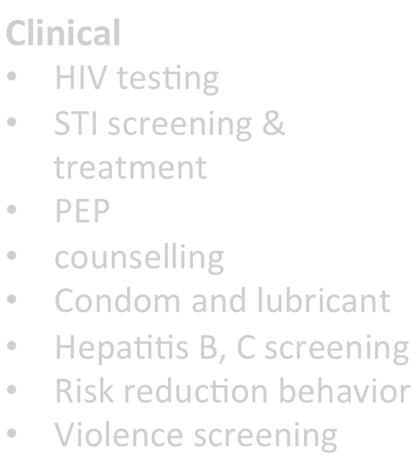






















What can we do better and how
essential package for KPs
Essential package + LVCT Health
WHERE HOW
Clinical
Evidence based interventions Clinical services
ART initiation& reﬁll
Blood draws for lab tests
monitoring and creatinine
baselines ( PrEP)
Partner notiﬁcation services
FSW -Cervical cancer screening; Family planning
HIV testing
STI screening & treatment
PEP
counselling
•
•
•
•
Drop in Centres (DICEs)
Facility based
Condom and lubricant HepaBBs B, C screening Risk reduction behavior Violence screening
Service Providers
KP
prevention
program
Service providers
Service providers
Clinical Services
HIV tesBng & Self tesBng
STI & TB screening & treatment
PrEP iniBation & support
PEP
ART iniBation & reﬁll
Blood draws for lab tests
Partner notiﬁcation services
Post violence care
FSW-Cervical cancer screening ; FP
PWID -needle and syringe provision; hepaBBs B tesBng and vaccination; MAT
referral
Peer led approach for service uptake
Non Clinical
•Health education
•Condoms & lubricants
•Needle and
syringes
Out reaches
Snowball mobilization
Referral for clinical services
Outreach (hotspots & mobilisationvenues)
•Referral to clinical services
Evidence based internveitons Psychosocial support
Service Providers & Peers
Peers

Slide 13
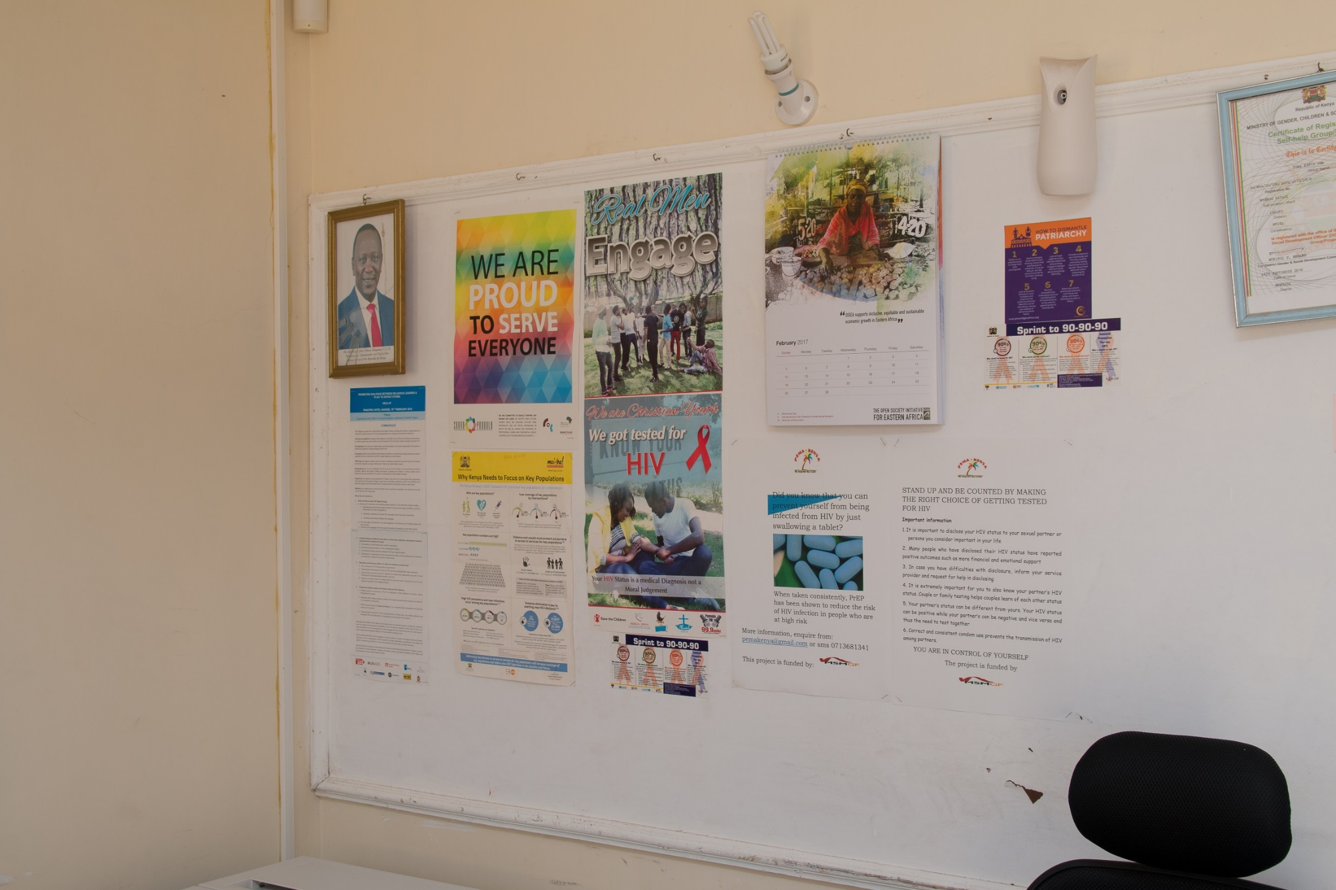

Results form the LVCT Health model
Improved
  Knowledge
  testing
  PreP uptake
  retention
#KENYAatAIDS2018

Slide 14
Towards a DSD prevention model
WHERE
Primarily HIV Service delivery sites/facilities for basic combination prevention package
Community-led settings for other primary prevention interventions beyond HIV e.g. safe spaces-
Demand driven
WHEN
Per guidelines
Per agreed schedule
Flexibility Based on individual current risk and need as assessed by provider or client
Individual`s Life cycle
Client
WHAT
Basic package of combination prevention interventions for all– Information; condoms; testing; risk reduction counseling; etc.
package differentiated by individual Changing HIV prevention needs
Focus on quality as much as targets
WHO
Build providers prevention capacities
Harnnes and build community competencies

Slide 15
Towards a DSD prevention model
WHEN
WHERE
WHAT
WHO
demographics
Life stage
individual
Available/accessible KP services
criminalization
Client
context
Health systems
Behavioral interventions
Substance use
Dropping out of school
violence
Mental health
Legal services
discrimination

Slide 16
what will it take to get there
Funding for primary prevention
Strong well resourced Community systems
  Community serving organisations
  Community-led organisations/initiatives
Community-facility synergy – some needs are better met at community safe spaces; layering and complementarity of services
meaningful engagement of communities in design of programs and services
Strong program leadership for prevention in national programs

Slide 17
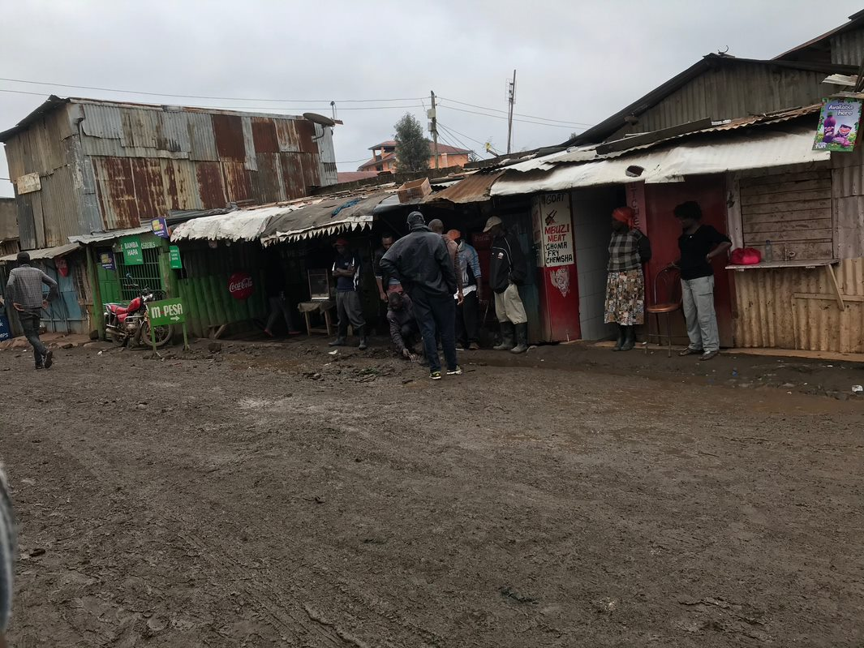
what will it take to get there
SERVICES
Flexibility- of providers, delivery mechanism, donors
Integration of services within and beyond health
Innovation
Improve provider capacities
Only 21.5% of sexual minorities in Kenya visit a health care provider when they have sexual and reproductive health problems (NASCOP, 2016).

Slide 18
Conclusion
People at the centre
Rethink a DSD prevention frameworks in different contexts
Examples promising practice
Context specific
Respond to individual need
Prevention not solely in clinics

Slide 19

Acknowledgement
  David Barr
  Saiqa Mullick, Wits RHI
  Imelda Mahaka, PZAT
  Joep Lange Institute
www.lvcthealth.org
LVCT Health
#KENYAatAIDS2018

